Slide 1
Requirements Modeling and
Use Case Diagrams
Instructor: Dr. Hany H. Ammar
Dept. of Computer Science and Electrical Engineering, WVU

Slide 2
outline
Review of development phases and UML Development – Overview
Requirements Engineering and the Requirements model
Introduction and importance of Use Case Diagrams
Use Case Diagram Rules
Examples of Use Case diagrams
Requirements Elicitation Process
    Identify Actors
    Identify Scenarios
    Identify Use Cases
    Refine Use Cases
    Identify Relationships between actors and Use Cases
    Identify Initial Analysis Objects
    Identify Non-functional requirements

Slide 3
Review: Phases of System Development
Requirements: Develop the Requirements Model
Requirements
Engineering
Analysis: Develop the Logical Model
Design: Develop the Architecture Model
Engineering
Design
Implementation
Testing

Slide 4


Workflows and Models
UML diagrams provide views into each model
Requirements
Use Case
Model
Analysis
Analysis
Model
Design
Design
Depl.
Model
Model
Implementation
Impl.
Model
Test
Test
Model
Each workflow is associated with one or more models.

Slide 5
Use Case Model
Use Case
Diagrams
Use Case
Model
Class
Diagrams
Object
Diagrams
Analysis
Component
Diagrams
Model
Design
Deployment
Diagrams
Model
Sequence
Diagrams
Depl.
Model
Collaboration
Diagrams
Impl.
Model
Statechart
Diagrams
Test
Model
Activity
Diagrams

Slide 6

Analysis & Design Model
Use Case
Diagrams
Use Case
Model
Class
Diagrams
Object
Diagrams
Analysis
Component
Diagrams
Model
Incl. subsystems and packages
Design
Deployment
Diagrams
Model
Sequence
Diagrams
Depl.
Model
Collaboration
Diagrams
Impl.
Model
Statechart
Diagrams
Test
Model
Activity
Diagrams

Slide 7
Deployment and Implementation Model
Use Case
Diagrams
Use Case
Model
Class
Diagrams
Object
Diagrams
Analysis
Component
Diagrams
Model
Design
Deployment
Diagrams
Model
Incl. active classes and components
Sequence
Diagrams
Depl.
Model
Collaboration
Diagrams
Impl.
Model
Statechart
Diagrams
Test
Model
Activity
Diagrams

Slide 8
UML Development - Overview
ACTORS
REQUIREMENTS
ELICITATION
USE CASES
Time
SCENARIOS
D
Requirements
Engineering
System/Object
SEQUENCE
DIAGRAMS
A
T
ANALYSIS
CLASS DIAGRAM(S)
StateChart
DIAGRAMs
A
ANALYSIS
Specify Domain
Objects
D
OPERATION CONTRACTS
I
C
T
Architectural Design
Include
Design Objects
I
SUBSYSTEM CLASS/
OR COMPONENT
DIAGRAMS
DEPLOYMENT DIAGRAM
DESIGN SEQUENCE DIAG.
O
N
DESIGN DIAGRAMS
A
Detailed DESIGN
R
Object
Design
IMPLEMENTATION
CHOICES
IMPLEMENTATION
Activity DIAGRAMS
Y
IMPLEMENTATION
PROGRAM

Slide 9
outline
Review of development phases and UML Development – Overview
Requirements Engineering and the Requirements model
Introduction and importance of Use Case Diagrams
Use Case Diagram Rules
Examples of Use Case diagrams
Requirements Elicitation Process
    Identify Actors
    Identify Scenarios
    Identify Use Cases
    Refine Use Cases
    Identify Relationships between actors and Use Cases
    Identify Initial Analysis Objects
    Identify Non-functional requirements

Slide 10
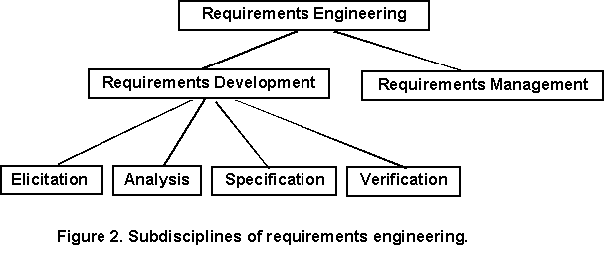
What is Requirements Engineering ?
Requirements Engineering

Slide 11
What is Requirements Engineering?
Requirements Management:
Requirements management activities include evaluating the impact of proposed changes, tracing individual requirements to downstream work products, and tracking requirements status during development
Several Requirements management tools are available in industry

Slide 12
What is Requirements Engineering?
Major Requirements Management Tools:
http://www.capterra.com/requirements-management-software
1. Caliber-RM by Technology Builders, Inc.; www.tbi.com
2. RequisitePro by Rational Software Corporation; www.rational.com
3. RTM Workshop by Integrated Chipware, Inc.; www.chipware.com

Slide 13
What is Requirements Engineering?
Requirements Elicitation
  is the process of gathering the different types of requirements from suitable stakeholders.
    Business requirements describe why the product is being built and identify the benefits for both the customers and the business.
    User requirements, describe the tasks or business processes a user will be able to perform with the product. (Developing use-cases)
    Functional requirements describe the specific system behaviors that must be implemented (Developing usage scenarios)
    Non-functional requirements, describe the non-functional features such as quality attributes of Reliability, Performance, availability, and maintainability.

Slide 14
What is Requirements Engineering?
Requirements analysis:
Requirements analysis includes decomposing high-level requirements into detailed functional requirements, constructing graphical requirements models or logical models (structured Analysis models, or Object-Oriented Analysis models) (for developers), and building prototypes.
Analysis models and prototypes provide alternative views of the requirements, which often reveal errors and conflicts that are hard to spot in a textual SRS.

Slide 15
What is Requirements Engineering?
Requirements Specification
Specification key practice is to write down the requirements in some accepted, structured format as you gather and analyze them.
The objective of requirements development is to communicate a shared understanding of the new product among all project stakeholders.
Historically, this understanding is captured in the form of a textual SRS document written in natural language, augmented by appropriate analysis models. (to be discussed in detail)

Slide 16
What is Requirements Engineering?
Requirements Verification
Verification involves evaluating the correctness, completeness, unambiguity, and verifiability of the requirements, to ensure that a system built to those requirements will satisfy the users’ needs and expectations. The goal of verification is to ensure that the requirements provide an adequate basis to proceed with design
Prototyping (or executable specifications) is a major technique used in verification. Examples include GUI development for user requirements verification, and Formal requirements specification environments

Slide 17
Requirements Engineering:
The Requirements Model
Problem statement
The Requirements
Elicitation
Process
Functional/
Nonfunctional
Requirements
Use Case Diagrams/
Sequence Diagrams
(the system level)
The Object-Oriented
Analysis
Process
Static Analysis
Dynamic Analysis
- Class Diagrams
- State Diagrams/
Refined Sequence
Diagrams (The object
level)

Slide 18
outline
Review of development phases and UML Development – Overview
Requirements Engineering and the Requirements model
Introduction and importance of Use Case Diagrams
Use Case Diagram Rules
Examples of Use Case diagrams
Requirements Elicitation Process
    Identify Actors
    Identify Scenarios
    Identify Use Cases
    Refine Use Cases
    Identify Relationships between actors and Use Cases
    Identify Initial Analysis Objects
    Identify Non-functional requirements

Slide 19
Use Case Diagrams
Introduction and importance
Use cases are widely regarded as one of the important artifacts needed to successfully develop complex software systems
Use cases define the scope of the system and clarify the behavioral system requirements

Slide 20
Use Case Diagrams
Introduction and importance
Provide a basis for a coherent conceptual understanding of the system under consideration without requiring knowledge of software design or implementation technology
Used as organized means of capturing domain expertise

Slide 21
Use Case Diagrams
Introduction and importance
Can be used to track the progress of the system development effort
Provide means to trace requirements to the design
Provide the basis for developing system acceptance tests

Slide 22
Use Case Driven
Req.ts
Analysis
Design
Impl.
Test
Use Cases bind these workflows together

Slide 23
Use Cases Drive Iterations
Drive a number of development activities
  Creation and validation of the system’s architecture
  Definition of test cases and procedures
  Planning of iterations
  Creation of user documentation
  Deployment of system
Synchronize the content of different models

Slide 24
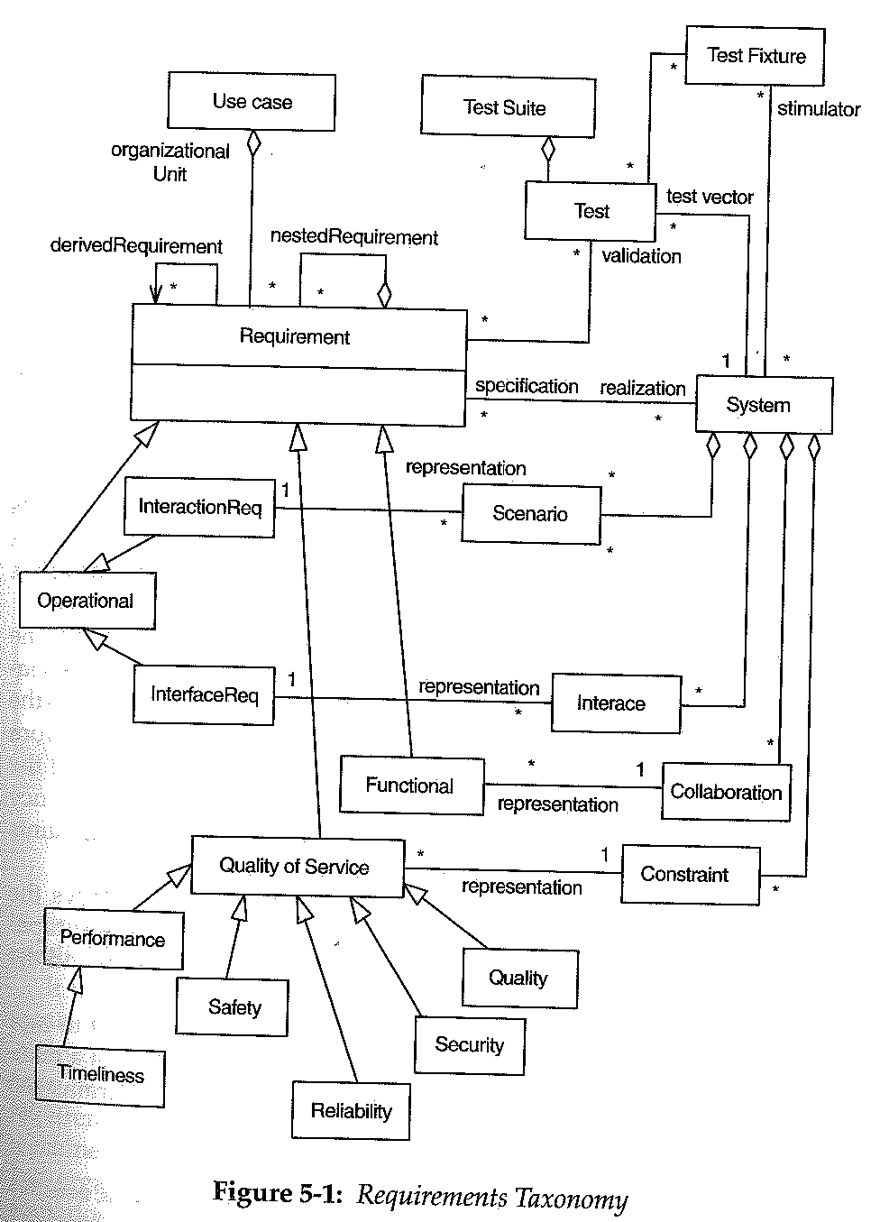

Slide 25
Use Case Diagrams
Introduction and importance
The identification of use cases and actors occurs during the initial requirements analysis phase of a project
The use cases most essential to the system are selected, analyzed, and specified.

Slide 26
Use Case Diagrams
Introduction and importance
These essential use cases eventually become the basis for defining the architecture of the system during the first iterations of system development
The use cases are then allocated to iterative releases, which are planned and eventually executed

Slide 27
Use Case Diagrams
Introduction and importance
In the requirements phase of each delivery, the use cases allocated to that delivery are analyzed and completely specified
the use cases would then be realized by domain level analysis/design using class and interaction diagrams

Slide 28
Use Case Diagrams
Introduction and importance
The domain level realization is further refined into a detailed design that typically employs class and interaction diagrams and often includes state transition diagrams and/or decision tables.

Slide 29
outline
Review of development phases and UML Development – Overview
Requirements Engineering and the Requirements model
Introduction and importance of Use Case Diagrams
Use Case Diagram Rules
Examples of Use Case diagrams
Requirements Elicitation Process
    Identify Actors
    Identify Scenarios
    Identify Use Cases
    Refine Use Cases
    Identify Relationships between actors and Use Cases
    Identify Initial Analysis Objects
    Identify Non-functional requirements

Slide 30
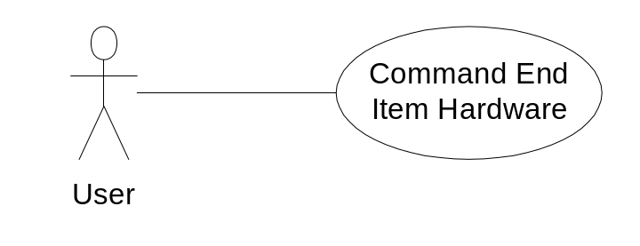
Use Case Diagrams
Use Case Diagram Rules
  Use a “stick man” figure for an actor, and show the actor’s name below the stick man
  The UML standard allows for the option of using a class rectangle with the stereotype «actor»
<<Stereotype>>
«actor»
Sensor

Slide 31
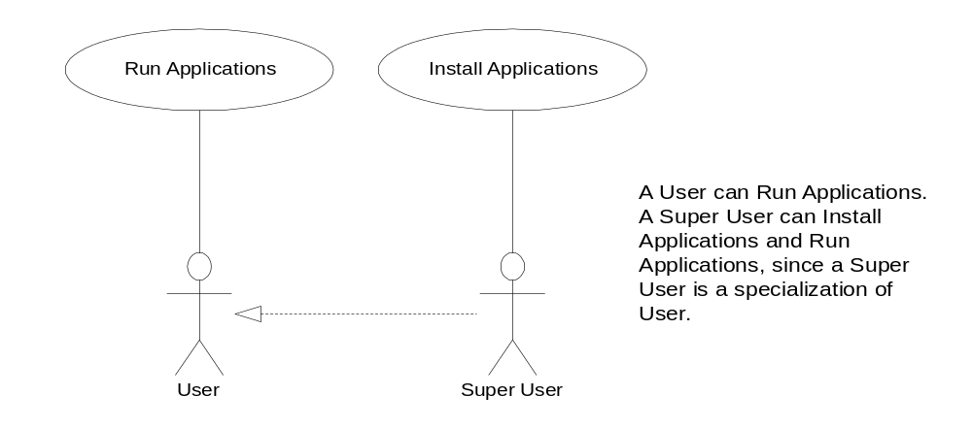
Use Case Diagram Rules
The only valid relationship between an actor and another actor is generalization

Slide 32
Use Case Diagram Rules
Use only the following relationships between use cases
  Use the include relationship to show that the behavior of one use case is wholly and unconditionally used in another use case
  Use the generalization relationship to show that a use case is a specialization of another use case

Slide 33
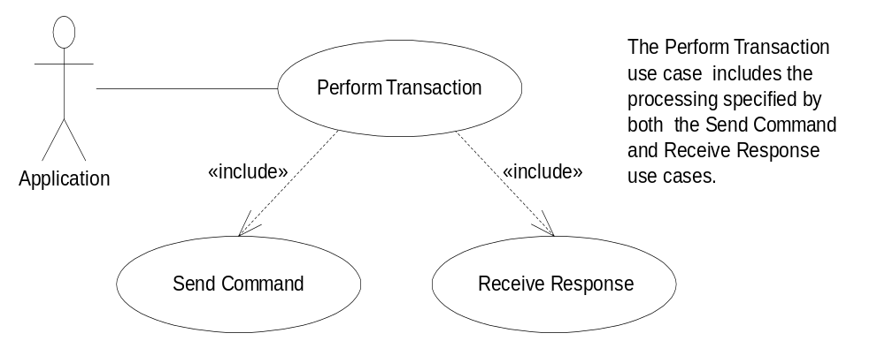
Use Case Diagram Rules
the include relationship

Slide 34
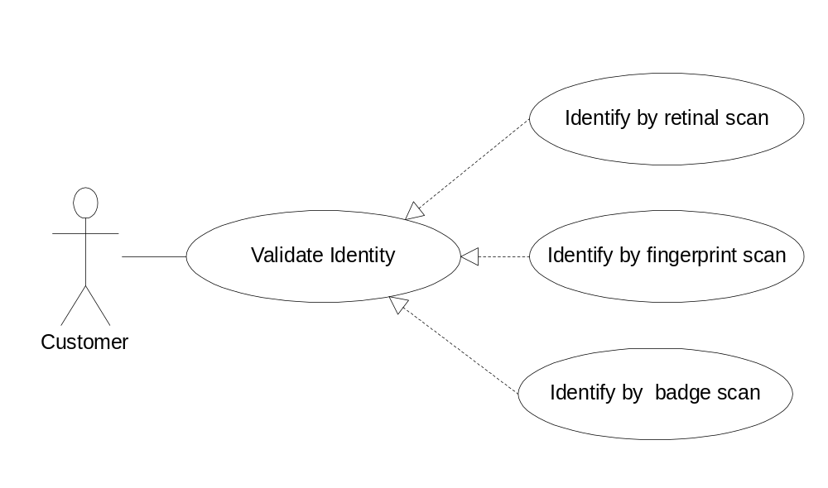
Use Case Diagram Rules
the generalization relationship

Slide 35
Use Case Diagram Rules
Use the extend relationship to show that one use case conditionally augment (or extend) the behavior of another use case.

Slide 36
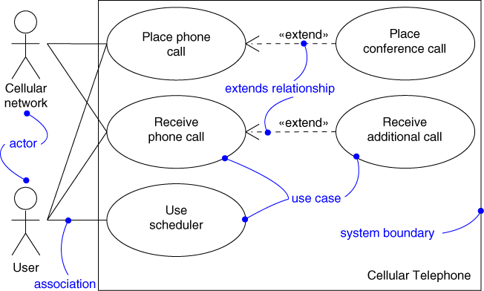
Example of Extends relationship

Slide 37
Use Case Diagram Rules
Extension points for a base use case are identified within the specification of that base use case
These are the locations where another use case may extend the base use case. These extension points are optionally shown in a diagram by listing them in a compartment of the base use case bubble under the heading “extension points
The extending relationship identifies, within parenthesis, the extension point(s) in the use case being extended

Slide 38
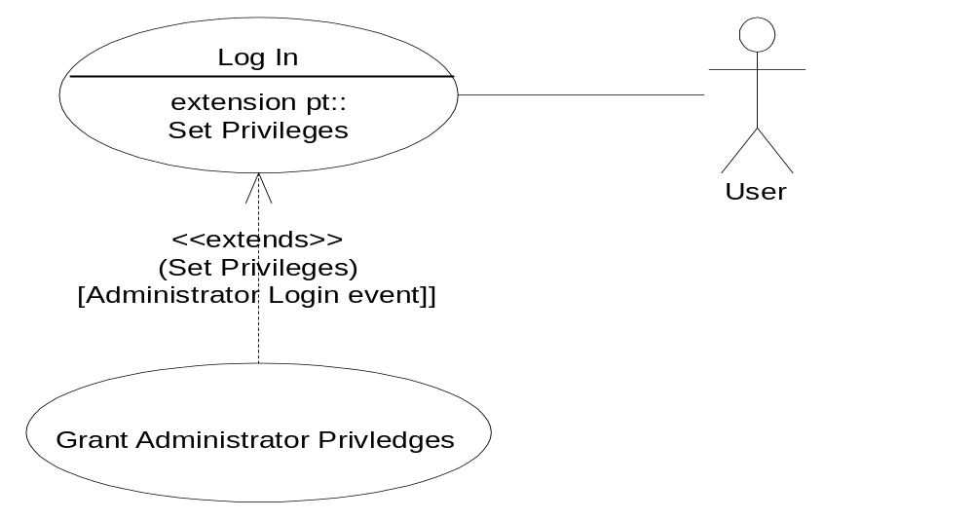
Identify, within brackets, the condition under which the extension is executed

Slide 39
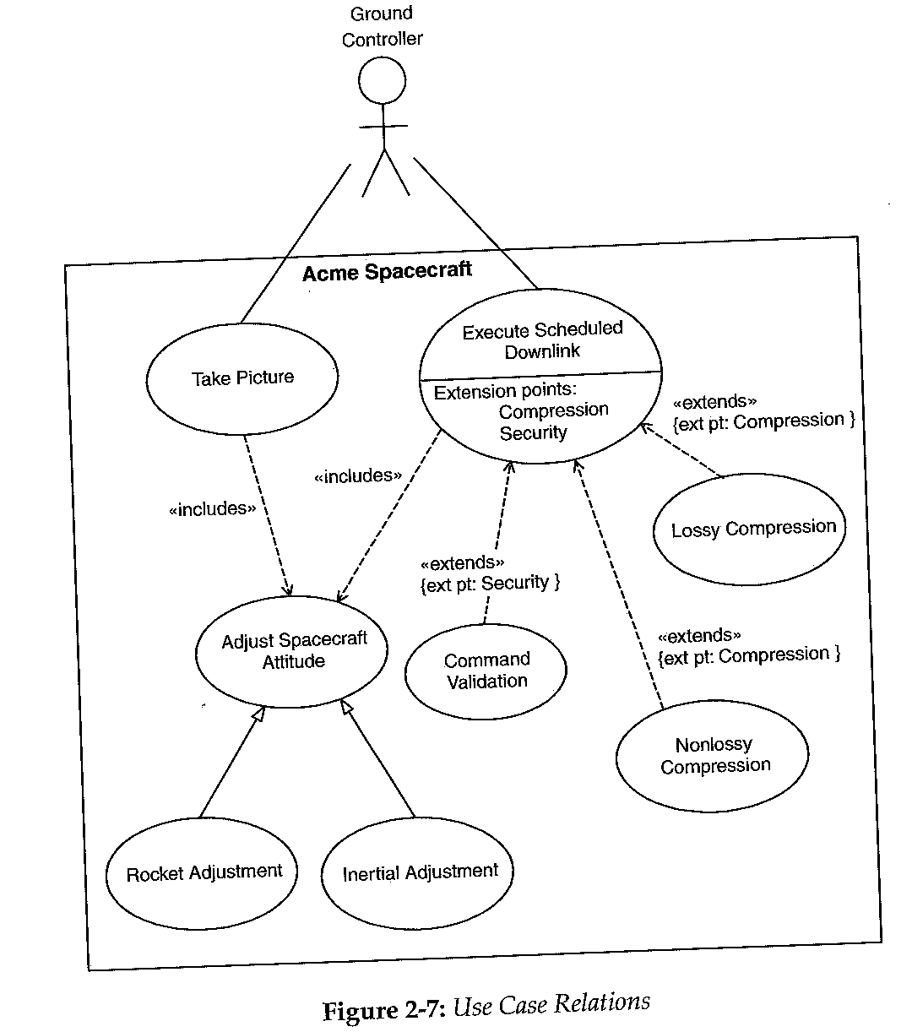
Example of Extends, includes, and generalization relationships

Slide 40
Use Case Diagram Rules
There must be one extension point listed for each segment identified in the extension use case
Although considered optional, it is recommended that the extending relationship also identify, within brackets, the condition under which the extension is executed

Slide 41
Use Case Diagram Rules
Use Case Packages
Use cases are often written and organized in layers of abstractions using Use Case Packages
A use case package contains a number of actors, use cases, their relationships, and perhaps other packages
A Use Case Package

Slide 42
Use Case Diagrams and Packages
Use the system
Use case package

Slide 43
outline
Review of development phases and UML Development – Overview
Requirements Engineering and the Requirements model
Introduction and importance of Use Case Diagrams
Use Case Diagram Rules
Examples of Use Case diagrams
Requirements Elicitation Process
    Identify Actors
    Identify Scenarios
    Identify Use Cases
    Refine Use Cases
    Identify Relationships between actors and Use Cases
    Identify Initial Analysis Objects
    Identify Non-functional requirements

Slide 44
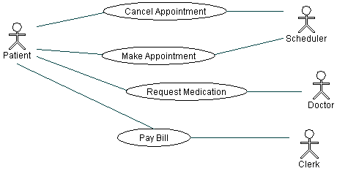
Examples of Use Case Diagrams
Example 1: Medical Clinic Software,
could be missing use case relations
Each use-case is described further by textual document and by
Scenarios developed using UML sequence diagrams

Slide 45
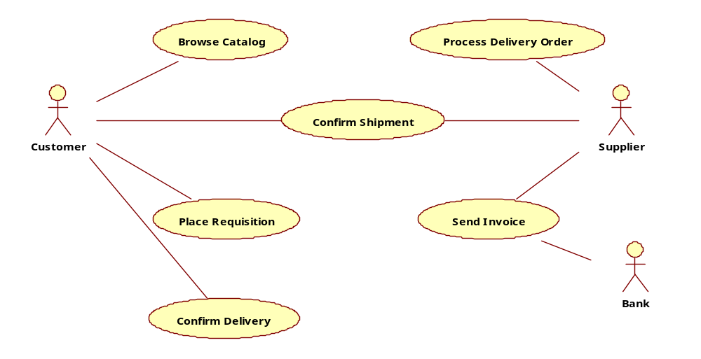
Example 2: E-Commerce Application (Incomplete)
Missing a link between “Place Requisition” and “Supplier” and missing use case relationships

Slide 46
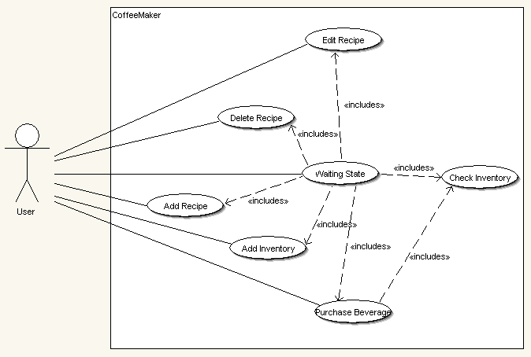
Example 3: Coffee Maker, “waiting state”
Not a good name for a use-case (bad example)

Slide 47
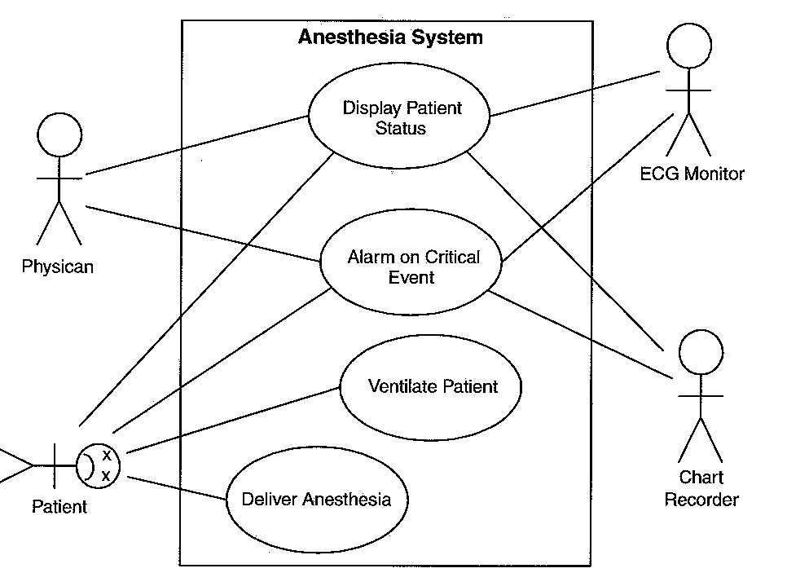
Example 4: Anesthesia System
(Incomplete)

Slide 48
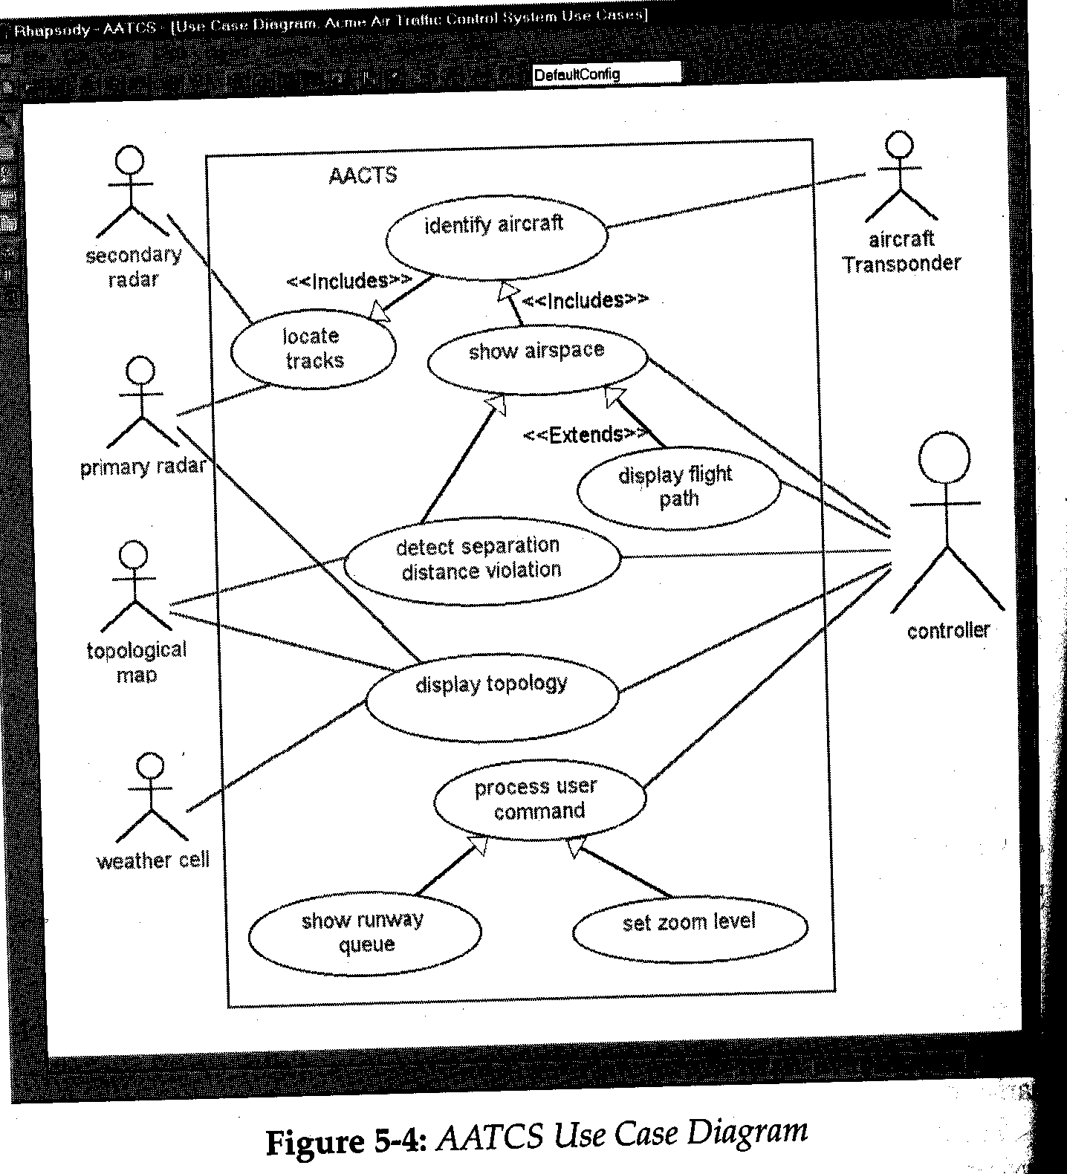
Example 5:
Automated
Air
Traffic
Control
System
(AATCS)

Slide 49
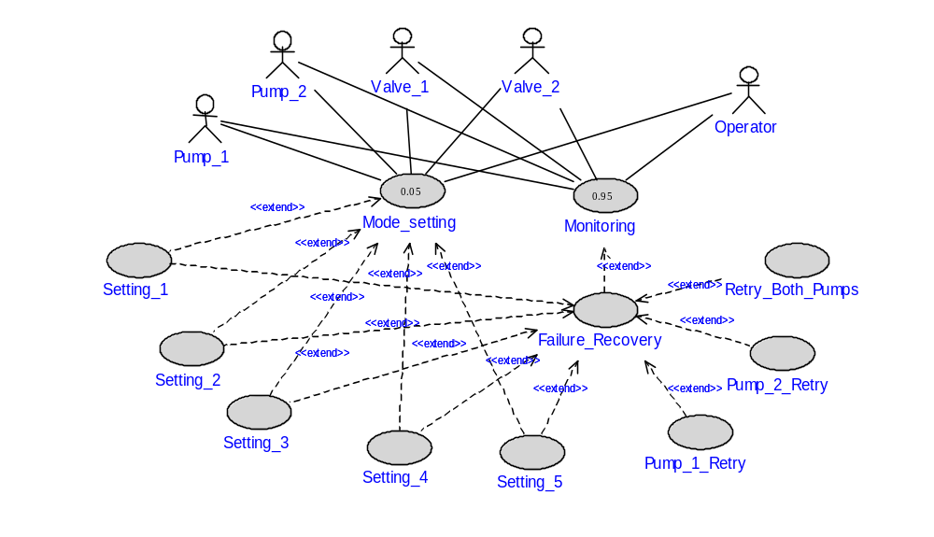
Example 6: Use case diagram of the Internal Thermal Control subsystem (NASA-ISS project) Showing probabilities of use cases

Slide 50
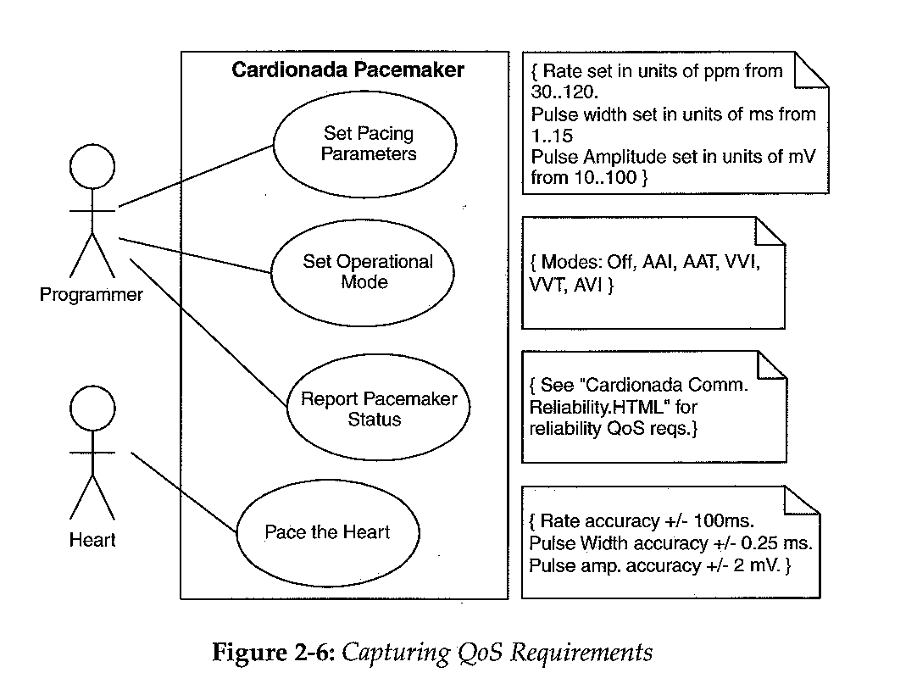
Example 7: Showing QoS Reqrs. Using UML notes

Slide 51
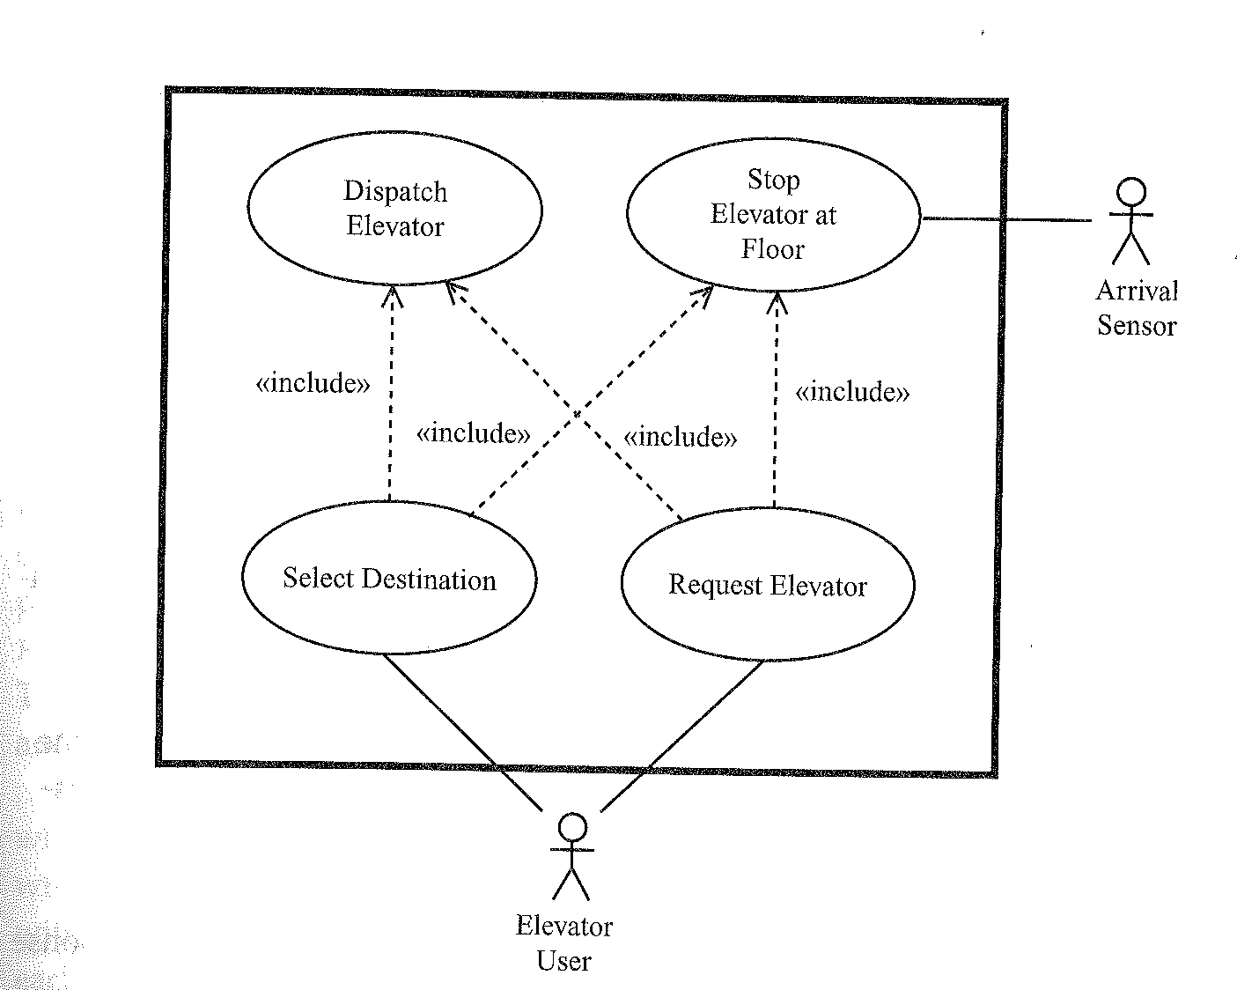
Example 8: Elevator Control System

Slide 52
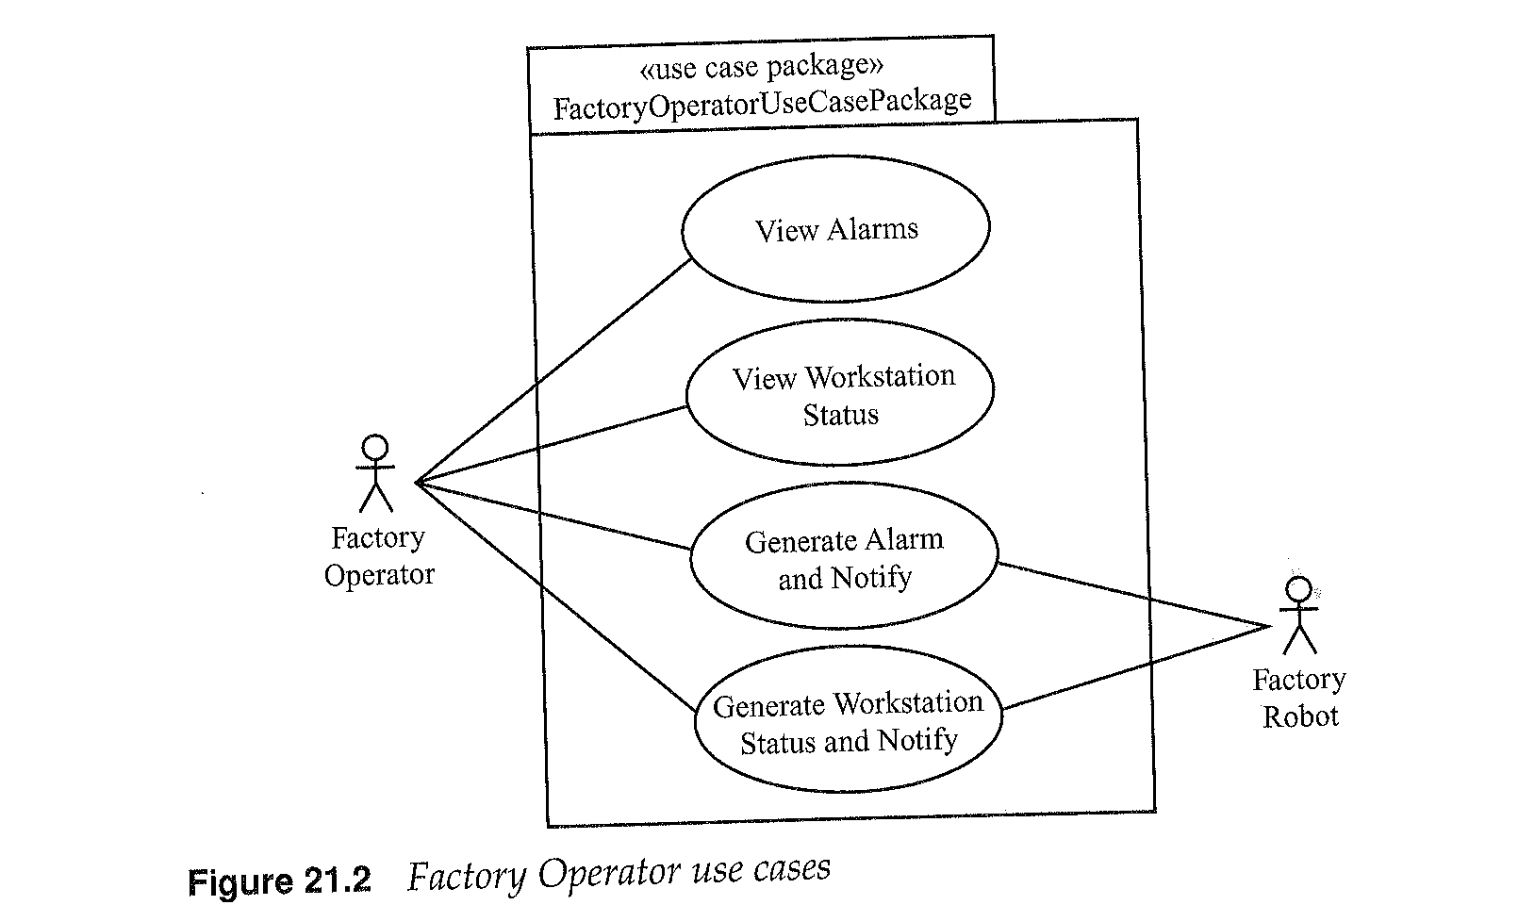
Example 9: Factory Control System,
consists of several packages of use cases

Slide 53
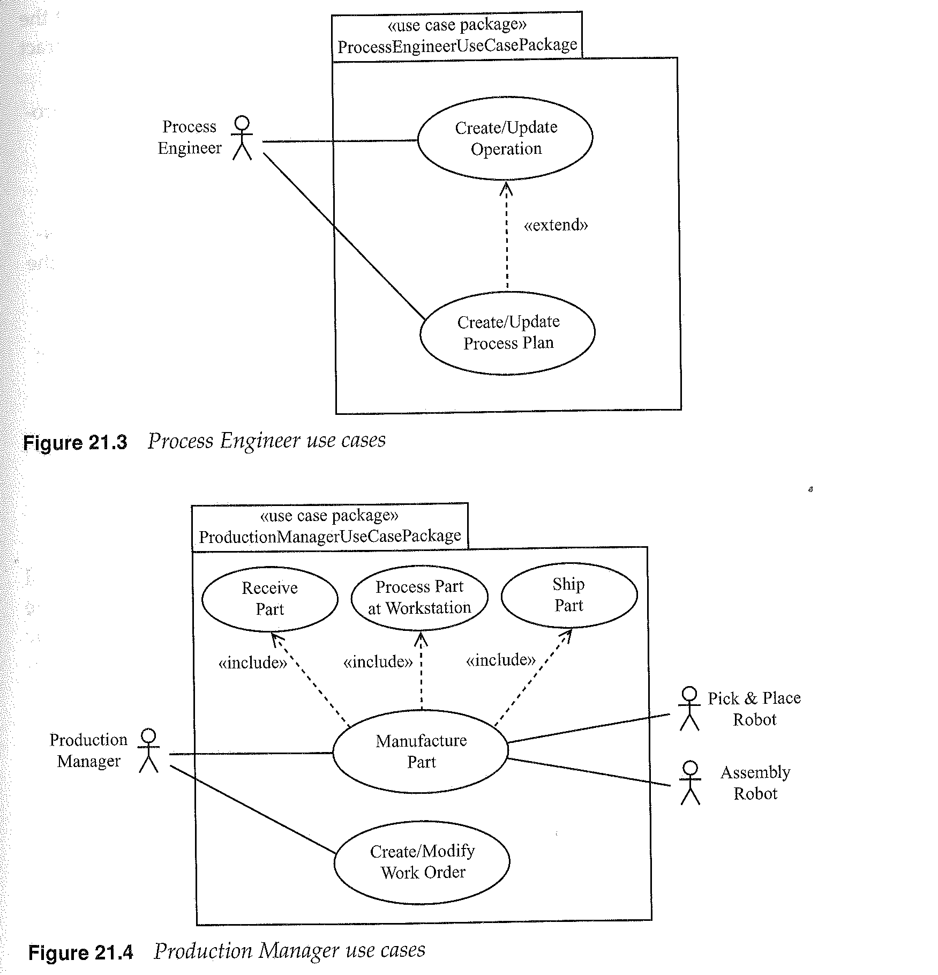
Example 9: Factory Control System (cont.)

Slide 54
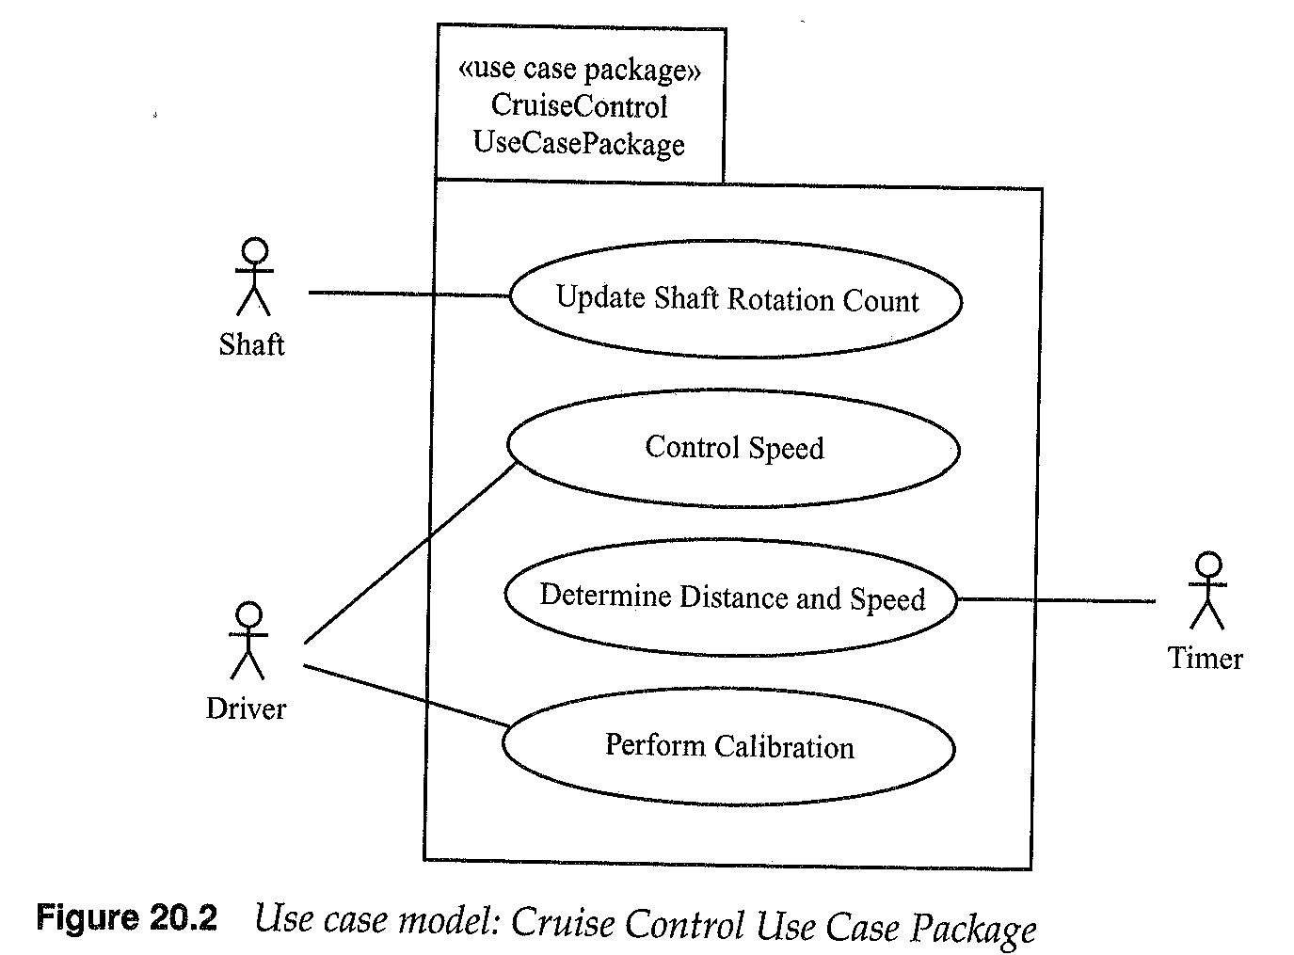
Example 10: Cruise Control and Monitoring System: Cruise Control Package

Slide 55
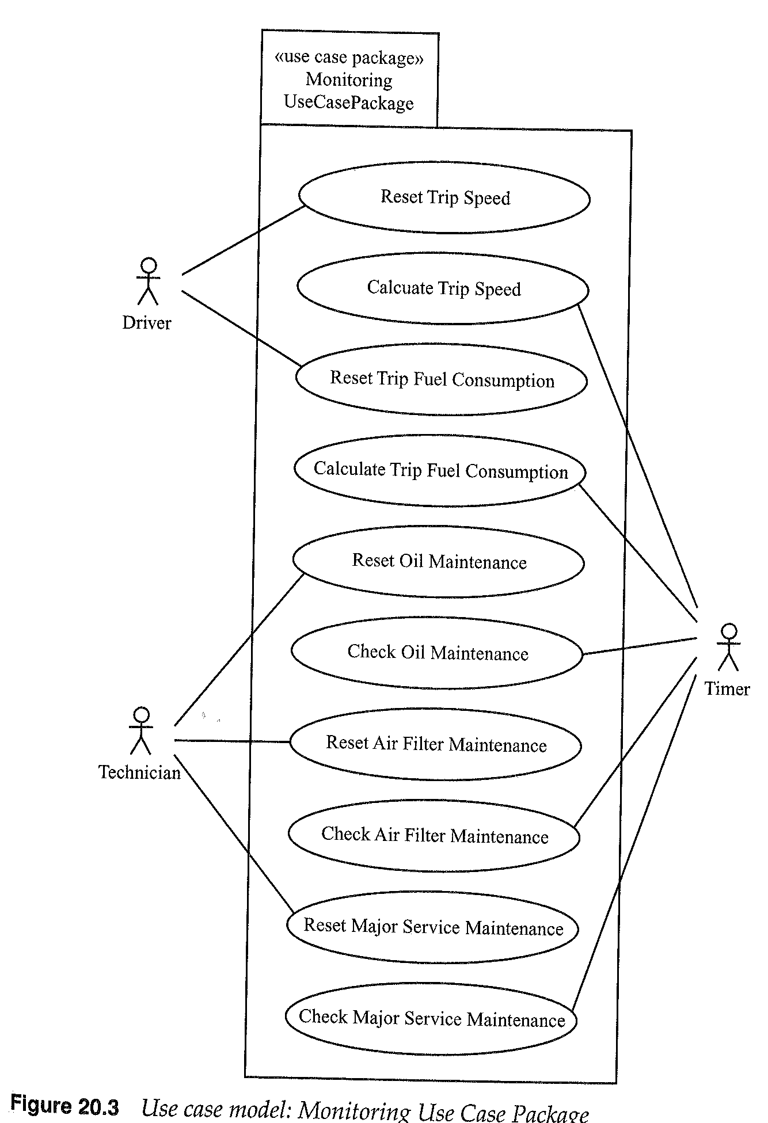
Example 10: Cruise Control and Monitoring System (cont.):
Monitoring Package
Not Good
Too many
use cases,
try to
aggregate

Slide 56
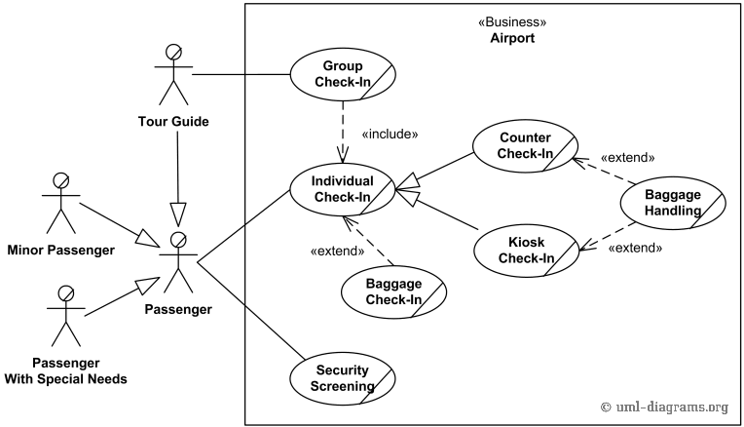
Example 11: Airport Check-in

Slide 57
outline
Review of development phases and UML Development – Overview
Requirements Engineering and the Requirements model
Introduction and importance of Use Case Diagrams
Use Case Diagram Rules
Examples of Use Case diagrams
Requirements Elicitation Process
    Identify Actors
    Identify Scenarios
    Identify Use Cases
    Refine Use Cases
    Identify Relationships between actors and Use Cases
    Identify Initial Analysis Objects
    Identify Non-functional requirements

Slide 58
Requirements Elicitation Process
The process of requirements elicitation consists of the following steps
    Identify Actors
    Identify Scenarios
    Identify Use Cases
    Refine Use Cases
    Identify Relationships between actors and Use Cases
    Identify Initial Analysis Objects
    Identify Non-functional requirements

Slide 59
Requirements Elicitation Process
  Identifying Actors: Identify the users or external entities the system will interact with or support.
    Examples: Medical Clinic Software: Patient, Doctor, Scheduler, and the Clerk
    Actors may have a generalization relationship

Slide 60
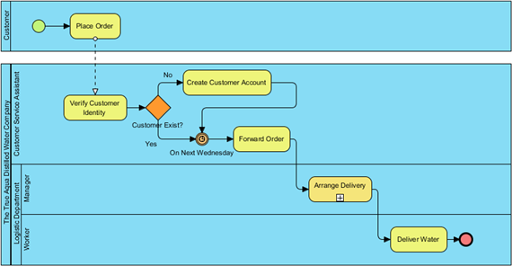
Requirements Elicitation Process
Identifying Actors from Business process models
http://www.visual-paradigm.com/product/ag/tutorials/frombptouc.jsp

Slide 61
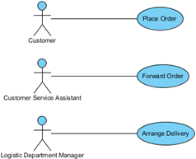
Requirements Elicitation Process
Identifying Actors from Business process models
http://www.youtube.com/watch?v=d4_yvQwC66o

Slide 62
Requirements Elicitation Process
2. Identify Scenarios of usage (user/actor stories): these are examples of typical user or actor interactions with the system. The are defined by a flow of events
Example 1: Medical Clinic Software: in one scenario, the patient will contact the scheduler to make an appointment he finds an answer that office is closed, in another scenario he will contact the doctor to request medication, the doctor responds to him with the name of the medication

Slide 63
Requirements Elicitation Process
2. Identify Scenarios of usage (cont.)
Example 3: The Coffee Maker waits for user input. There are six options to chose from: 1) add recipe, 2) delete a recipe, 3) edit a recipe, 4) add inventory, 5) check inventory, and 6) purchase beverage, the user chooses to delete a recipe which does not exist.
Recall that the scenarios are user driven and not system driven (user perspective)

Slide 64
Requirements Elicitation Process
3. Identify Use Cases: Once scenarios of usage are identified, use cases are defined to model the main user-based processes of the system.
Example: identify the “Make an Appointment” use case from one scenario and the “Request Medication” from another scenario

Slide 65
Requirements Elicitation Process
The process of requirements elicitation consists of the following steps
    Identify Actors
    Identify Scenarios
    Identify Use Cases
    Refine Use Cases
    Identify Relationships between actors and Use Cases
    Identify Initial Analysis Objects
    Identify Non-functional requirements

Slide 66
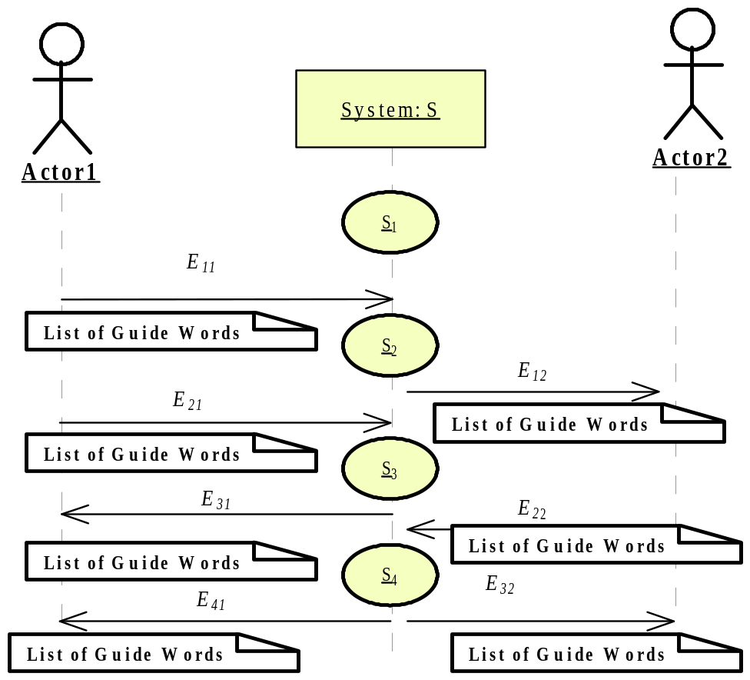
Requirements Elicitation Process
4. Refine Use Cases: describe the details of each use case. A Textual template is used as well as UML interaction diagrams (UML sequence diagrams or object collaboration diagrams).
Textual: Brief Description, Actors, Preconditions, Basic Flow of Events,
Alternate flow of events,
System
Sequence
Diagram

Slide 67
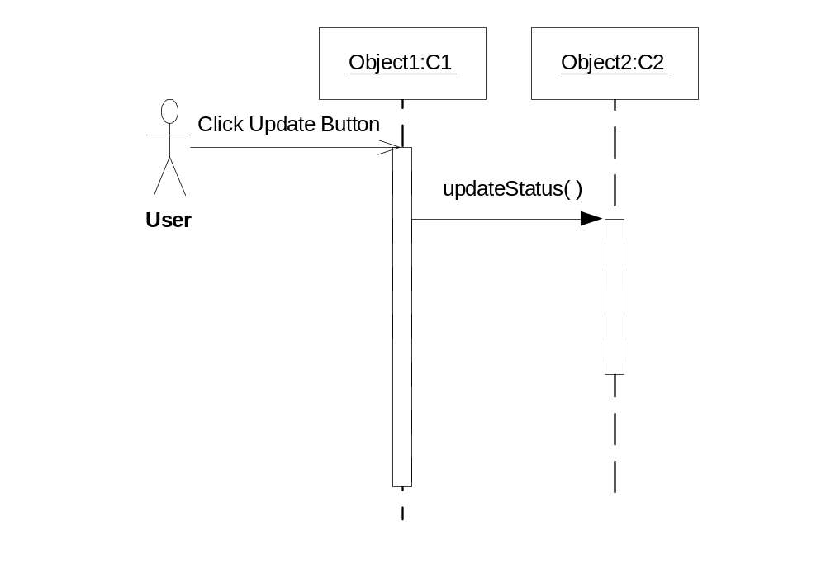
Requirements Elicitation Process
4. Refining Use Cases (cont.)
Sequence Diagrams capture scenarios
(to be discussed later in slides 4)

Slide 68
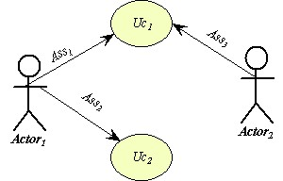
Requirements Elicitation Process
4. Refining Use Cases (cont.)
System Sequence Diagram
The sequence diagram of use case UC1
System S
Use-case
diagram

Slide 69
Requirements Elicitation Process
4. Refining Use Cases (cont.)
A Template for textual description of Use Cases
Use Case name: Name of Use Case, which should be related to the result, purpose or the event of the Use Case.
Purpose:The main purpose of the Use Case and what the participants expect of the transaction.
Description: A paragraph(s) describing the goal(s) and the scenario(s) illustrated by this Use Case.

Slide 70
Requirements Elicitation Process
4. Refining Use Cases (cont.)
A Template for textual description of Use Cases (cont.)
Actors: Who or what participates in the Use Case. That includes what individuals, organizations, job functions, software applications, software functions or machines collaborate in the Use Case.
Data Content: What data are in scope of this Use Case. What information is exchanged in the transactions that implement the Use Case.
Preconditions: What conditions are expected to exist prior to the start of the Use Case.
Begins When: What starts or triggers the performance of this Use Case.

Slide 71
Requirements Elicitation Process
4. Refining Use Cases (cont.)
A Template for textual description of Use Cases (cont.)
Ends When: When is the Use Case finished.
Exceptions: What exceptional outcomes are there besides the normal one expected for a successful performance of the Use Case.
Post Conditions: What is the state of "the system" after the Use Case has been completed
References: If this Use Case references other works or documents, or other Use Cases the references to these sources are placed here

Slide 72
Requirements Elicitation Process
4. Refining Use Cases (cont.)
A simplified example of some sections: The Coffee Maker
UC3: Flow of Events for the Delete Recipe Use Case
3.1 Preconditions: recipes exist in the system
3.2 Main Flow: The user will be shown a list of all recipes in the system, and asked to choose the recipe, by number, that they wish to delete. [S1][E1][E2]
3.3 Subflows:
[S1] If the user selects an empty recipe to delete, the user is returned to the main menu.
3.4 Alternative Flows:
[E1] If the user selects a number that is out of bounds of the number of recipes, the user is returned to the main menu.
[E2] If the user enters a alphabetic character, the user is returned to the main menu. .

Slide 73
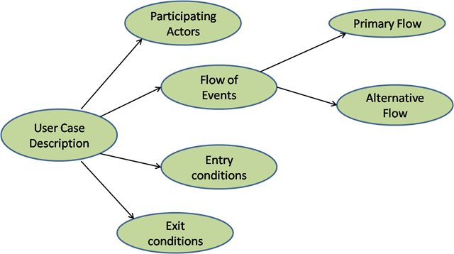
The components of Use case description template

Slide 74
Requirements Elicitation Process
The process of requirements elicitation consists of the following steps
    Identify Actors
    Identify Scenarios
    Identify Use Cases
    Refine Use Cases
    Identify Relationships between actors and Use Cases
    Identify Initial Analysis Objects
    Identify Non-functional requirements

Slide 75
Requirements Elicitation Process
5. Identify Relationship among Actors and Use Cases:
    Establish and Label (initiate, set, or get) the association or communication relationship between actors and use cases
    Establish include, extend or generalization relationships between use cases
      Use include to factor out redundancies for “common” use cases (or utility Use Cases) used by other use cases
      Use extend to show use cases having added functionality to other use cases
      Use generalization to add abstraction or subtype cases between use cases

Slide 76
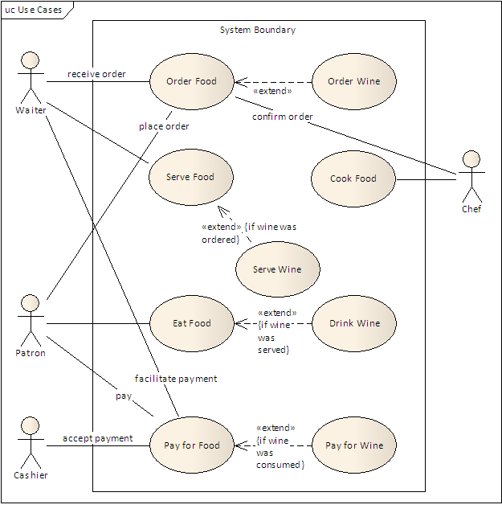
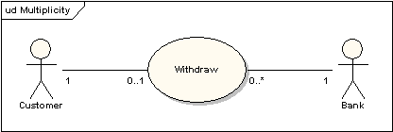
Label Associatons,e.g. Receive order, and accept payment,
Identify Multiplicity of
associations

Slide 77
Requirements Elicitation Process
6. Identify Initial Analysis Objects
    These can be nouns or processes in the textual requirements (also called Domain objects)
    Types of objects may include:
      Interfaces to External Entities: Sensors, actuators, control panel, devices
      Information Items : Displays, Commands, etc.
      Entities which establishes the context of the system (to support Use case functionality): Controller, monitors, schedulers, handlers, servers, agents, wrappers

Slide 78
Requirements Elicitation Process
7. Identify Non-functional requirements
    Includes the following types:
    Usability: e.g. determined by the level of user expertise to determine user interface look and feel
    Reliability: determined by the risk of Failures (e.g. safety critical systems must have high level of reliability
    Performance: e.g. response time of usage scenarios, throughput (no of transactions processed per unit time)
    Maintainability (Supportability): the level of adaptive, perfective, and corrective maintenance
    Implementation/operation constraints

Slide 79
Use Case Diagrams
Used during requirements elicitation to represent external behavior
Actors represent roles, that is, a type of user of the system
Use cases represent a sequence of interaction for a type of functionality
The use case model is the set of all use cases. It is a complete description of the functionality of the system and its environment
Passenger
PurchaseTicket

Slide 80
Actors
An actor models an external entity which communicates with the system:
  User
  External system
  Physical environment
An actor has a unique name and an optional description.
Examples:
  Passenger: A person in the train
  GPS satellite: Provides the system with GPS coordinates
Passenger

Slide 81
Use Case
A use case represents a class of functionality provided by the system as an event flow.
A use case consists of:
Unique name
Participating actors
Entry conditions
Flow of events
Exit conditions
Special requirements
PurchaseTicket

Slide 82
Use Case Diagram: Example
Name: Purchase ticket
Participating actor: Passenger
Entry condition:
Passenger standing in front of ticket distributor.
Passenger has sufficient money to purchase ticket.
Exit condition:
Passenger has ticket.
Event flow:
1. Passenger selects the number of zones to be traveled.
2. _x0008_Distributor displays the amount due.
3. Passenger inserts money, of at least the amount due.
4. Distributor returns change.
5. Distributor issues ticket.
Anything missing?
Exceptional cases!

Slide 83
The <<extends>> Relationship
<<extends>> relationships represent exceptional or seldom invoked cases.
The exceptional event flows are factored out of the main event flow for clarity.
Use cases representing exceptional flows can extend more than one use case.
The direction of a <<extends>> relationship is to the extended use case
Passenger
PurchaseTicket
<<extends>>
<<extends>>
<<extends>>
OutOfOrder
<<extends>>
TimeOut
Cancel
NoChange

Slide 84
The <<includes>> Relationship
<<includes>> relationship represents behavior that is factored out of the use case.
<<includes>> behavior is factored out for reuse, not because it is an exception.
The direction of a <<includes>> relationship is to the using use case (unlike <<extends>> relationships).
Passenger
PurchaseMultiCard
PurchaseSingleTicket
<<includes>>
<<includes>>
<<extends>>
CollectMoney
<<extends>>
NoChange
Cancel

Slide 85
Use Case Diagrams: Summary
Use case diagrams represent external behavior
Use case diagrams are useful as an index into the use cases
Use case descriptions provide meat of model, not the use case diagrams.
All use cases need to be described for the model to be useful.

Slide 86
Use Cases
What is a Use Case
  A formal way of representing how a business system interacts with its environment.
  Illustrates the activities that are performed by the users of the system.
  A sequence of actions a system performs that yields a valuable result for a particular actor.

Slide 87
Use Cases
Use case diagrams depicts the interactions between the system and the external actors.
The emphasis is on what a system does rather than how.
Use case diagrams are closely connected to scenarios. A scenario is an example of what happens when someone interacts with the system.

Slide 88
Key points
The development team, with stakeholders involvement, writes the use cases.
Compared to traditional requirement methods, use cases are relatively easy to write and easier to read.
Free of technical or implementation details.

Slide 89
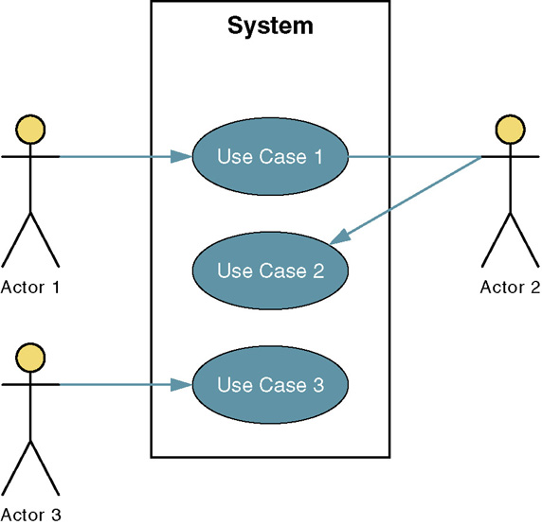
System name
Actor is a stick figure usually an actual person using the system
System boundary
The use case
Connection line shows which actor participate in the use cases

Slide 90
Use-Case components
An actor represents anything that interacts with the system.
An actor might be:
  a person
  a company or organization,
  a computer program, or a computer system
  Hardware
A use case is a sequence of actions a system performs that yields an observable result of value to a particular actor.
  Name each use case using Noun-Verb.
  The communication line to show how the actors communicate with the use case.
    Depicted by line or double-headed arrow line
Actor
  UseCase
٩
OOAD

Slide 91
Use Case Analysis
What is an Actor?
  A user or outside system that interacts with the system being designed in order to obtain some value from that interaction
Use Cases describe scenarios that describe the interaction between users of the system (the actor) and the system itself.

Slide 92
A Step-by-Step Guide to Building the Use-Case Model
Step 1: Identify and Describe the Actors
  Who uses the system?
  Who gets information from this system?
  Who provides information to the system?
  Where in the company is the system used?
  Who supports and maintains the system?
  What other systems use this system?

Slide 93
A Step-by-Step Guide to Building the Use-Case Model
Step 2: Identify the Use Cases and Write a Brief Description
  What will the actor use the system for?
  Will the actor create, store, change, remove, or read data in the system?
  Will the actor need to inform the system about external events or changes?
  Will the actor need to be informed about certain occurrences in the system?

Slide 94
A Step-by-Step Guide to Building the Use-Case Model
Step 3: Identify the Actor and Use-Case Relationships
  Only one actor can initiate a use case
  Many use cases may involve the participation of multiple actors.
  Each use case is analyzed to see what actors interact with it

Slide 95
Use Cases
Here is a scenario for a medical clinic.
A patient calls the clinic to make an appointment for a yearly checkup. The receptionist finds the nearest empty time slot in the appointment book and schedules the appointment for that time slot. "
We want to write a use case for this scenario.
Remember: A use case is a summary of scenarios for a single task or goal and An actor is who or what initiates the events involved in the task of the use case.

Slide 96

Use Cases
So as we read our scenario, what or who is the actor????
The actor is a Patient.
So What is the Use Case????
The Use Case is Make Appointment.

Slide 97

Use Cases
The picture below is a Make Appointment use case for the medical clinic.
The actor is a Patient. The connection between actor and use case is a communication association (or communication for short).
Actors are stick figures. Use cases are ovals. Communications are lines that link actors to use cases.

Slide 98
Use Case
Boundary
  A boundary rectangle is placed around the perimeter of the system to show how the actors communicate with the system.
Make
Appointment
Notes:
System boundary: A system boundary defines the scope of what a system will be. A system cannot have infinite functionality. So, it follows that use cases also need to have definitive limits defined. A system boundary of a use case diagram defines the limits of the system. The system boundary is shown as a rectangle spanning all the use cases in the system.
Other use cases in this lecture also show the system boundary of the clinic application. The use cases of this system are enclosed in a rectangle. Note that the actors in the system are outside the system boundary.
The system boundary is potentially the entire system as defined in the problem statement. But this is not always the case. For large and complex systems, each of the modules may be the system boundary. For example, for an ERP system for an organization, each of the modules such as personnel, payroll, accounting, and so forth, can form the system boundary for use cases specific to each of these business functions. The entire system can span all of these modules depicting the overall system boundary.

Slide 99
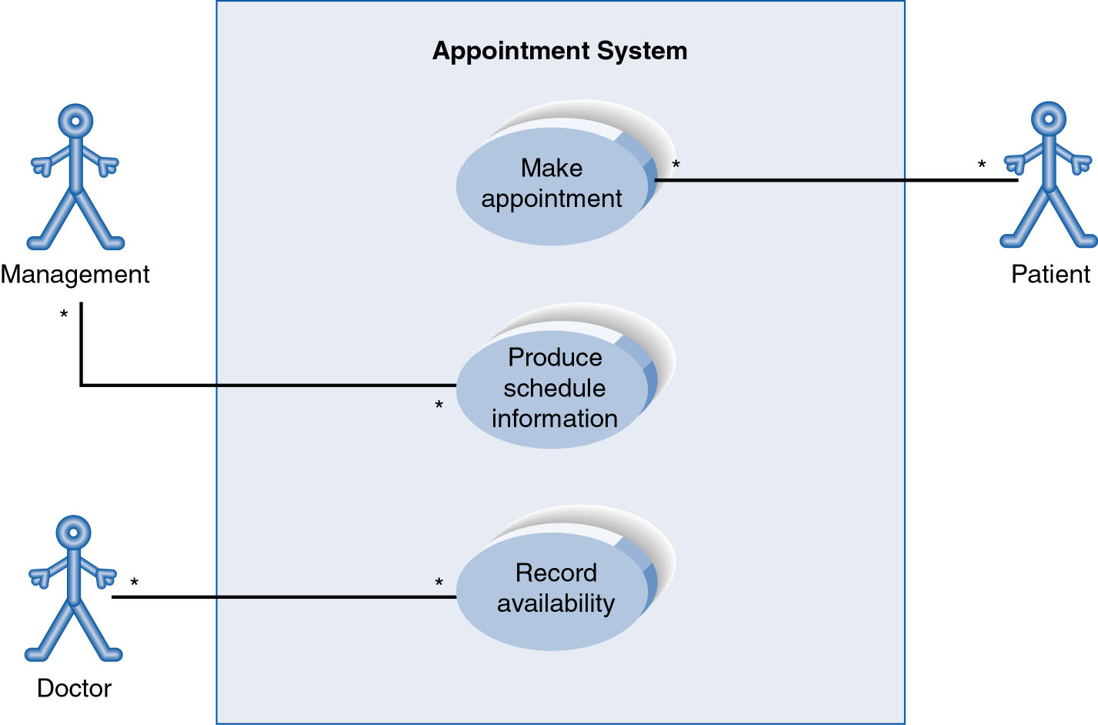
Use-Case Diagram
A use case diagram is a collection of actors, use cases, and their communications.
Notes:
Example Use Case
ACTORS
Represented by a stick figure
named
USE CASE
Represented by an oval
Named (POORLY NAMED; should be verb phrase)
RELATIONSHIP
2-way association

Slide 100
Use Case Diagram
Other Types of Relationships for Use Cases
  Generalization
  Include
  Extend
Notes:
Inheritance

Slide 101
Generalization Relationship
Much like superclasses in a class diagram
A generalized use case represents several similar use cases
One or more specializations provides details of the similar use cases
  Represented by a line and a hollow arrow
    From child to parent
Parent use case
Notes:
Inheritance
A use case generalization shows that one use case is simply a special kind of another.
A clinic may have a use case such as Pay Bill which would be a parent use case and Bill Insurance which is the child.
A child can be substituted for its parent whenever necessary.
Generalization appears as a line with a triangular arrow head toward the parent use case.

Slide 102
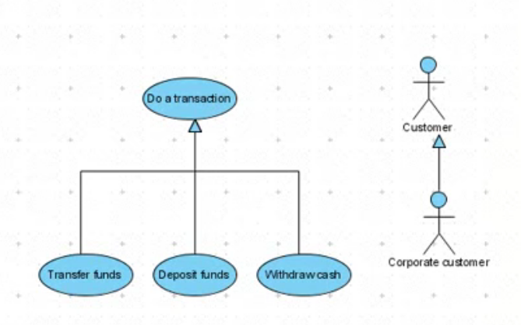
Generalization Relationship

Slide 103
Include Relationship
  use cases that are included as parts of other use cases.
  You have a piece of behavior that is similar across many use cases
  Break this out as a separate use-case and let the other ones “include” it
  Arrow is drawn from the base use case to the used use case
  Write << include >> above arrowhead line
Invoking use case
<<include>>
Included use case
Notes:
Include relationship
Notice that ONLY between use cases (not between actors)
MANDATORY functional
Multiple use cases may share pieces of the same functionality
Rather than have duplicate functionality in several use cases
Put shared functionality in one use case and show relationship between it and other use cases that “uses” its functionality
Depicted by arrowhead with word “<<include>>” above it
Include relationships factor use cases into additional ones.
Includes are especially helpful when the same use case can be factored out of two different use cases.
If a clinic had a cases of Make Appointment and Request Medication.
Both might include Check Patient Record as a subtask.
Both would include a call to the use case Check Patient Record.
We don’t want to write it twice we simply want to include in as a call from both.
In the diagram,
include notation is a dotted line beginning at base use case ending with an arrows pointing to the include use case.
The dotted line is labeled <<include>>.

Slide 104
Extend relationship
  use cases that extend the behavior of other core use cases.
  A use-case is similar to another one but does a little bit more
  Put the normal behavior in one use-case and the exceptional behavior somewhere else
  Arrow is drawn from the extension use case to the base use case
  Write << extend >> above arrowhead line
Base use case
<<extend>>
Extending use case
Notes:
Use Case Relationship
Extend relationship
Used to show optional behavior (behavior that is run only under certain circumstances)
Depicted by arrowhead with word “<<extend>>” above it
An extend relationship indicates that one use case is a variation of another.
This is often used when much of the same code may be in both only one extends the functionality somewhat.
A typical example is a add record to the database and modify that record.
So an add student is similar to a modify student so I may reuse some of the code.
Extend notation is a dotted line, labeled <<extend>>, and with an arrow toward the base case.
The extension point, which determines when the extended case is appropriate, is written inside the base case.

Slide 105

Examples
Include
Extend
Purchase Item
<<include>>
Verify
Credit card

Slide 106
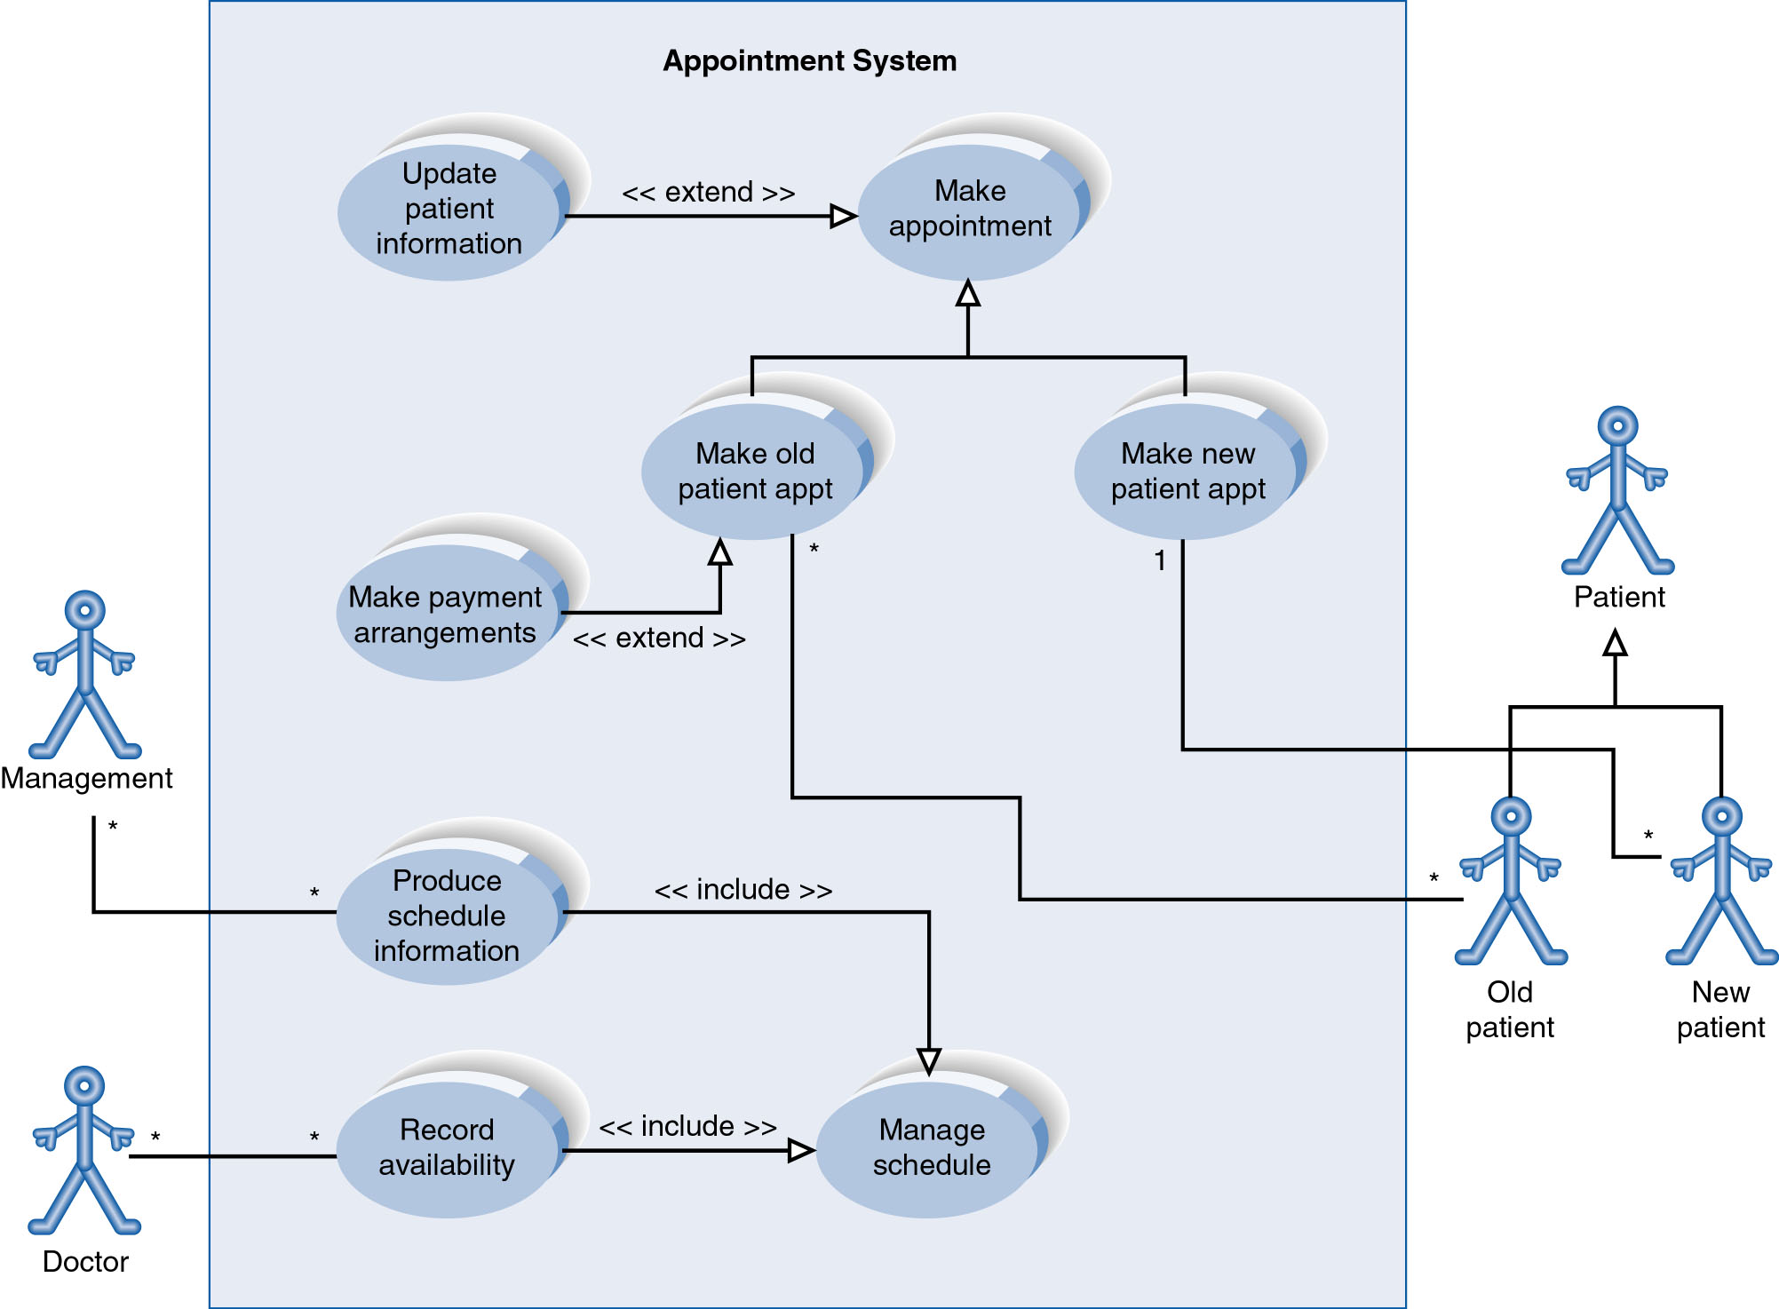
Example
Notes:
System Boundary
Use cases are enclosed within a system boundary
a box that represents the system and clearly delineates what parts of the diagram are external or internal to it
Name of the system can appear inside or on top of the box

Slide 107
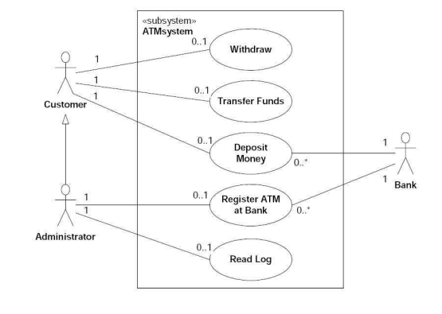
The simplified use case diagram of an ATM

Slide 108
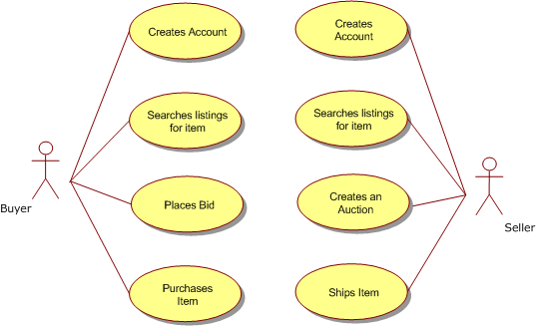
Example

Slide 109
Example
Suppose we want to develop software for an alarm clock. The clock shows the time of day. Using buttons, the user can set the hours and minutes fields individually, and choose between 12 and 24-hour display. It is possible to set one or two alarms. When an alarm fires, it will sound some noise. The user can turn it off, or choose to ’snooze’. If the user does not respond at all, the alarm will turn off itself after 2 minutes. ’Snoozing’ means to turn off the sound, but the alarm will fire again after some minutes of delay.
Try to model it with a use case diagram.

Slide 110
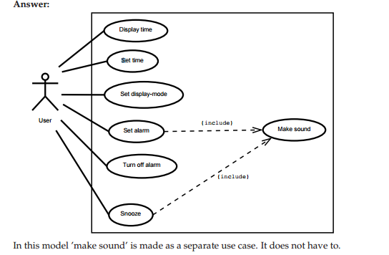

Slide 111
USE-CASE DIAGRAMS
Slide <number>
PowerPoint Presentation for Dennis, Wixom & Tegardem Systems Analysis and Design
Copyright 2001 © John Wiley & Sons, Inc. All rights reserved.

Slide 112
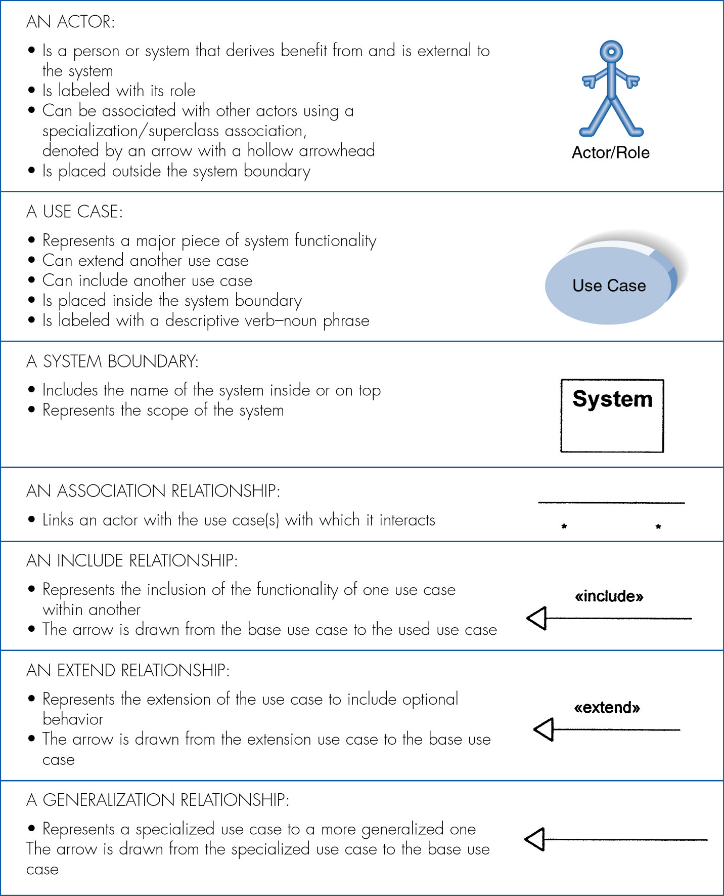
Syntax for Use-Case Diagram
PowerPoint Presentation for Dennis, Wixom & Tegardem Systems Analysis and Design
Copyright 2001 © John Wiley & Sons, Inc. All rights reserved.
Slide <number>

Slide 113
The Use-Case Diagram for Appointment System
PowerPoint Presentation for Dennis, Wixom & Tegardem Systems Analysis and Design
Copyright 2001 © John Wiley & Sons, Inc. All rights reserved.
Slide <number>

Slide 114
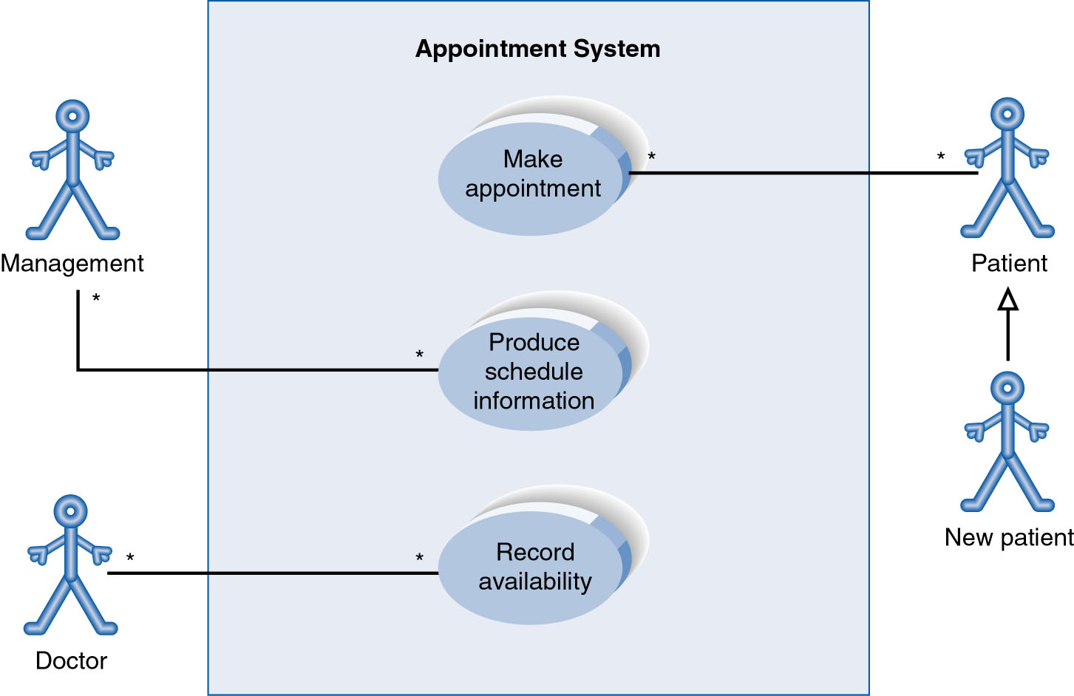
Use-Case Diagram with Specialized Actor
PowerPoint Presentation for Dennis, Wixom & Tegardem Systems Analysis and Design
Copyright 2001 © John Wiley & Sons, Inc. All rights reserved.
Slide <number>

Slide 115
Extend and Include Relationships
PowerPoint Presentation for Dennis, Wixom & Tegardem Systems Analysis and Design
Copyright 2001 © John Wiley & Sons, Inc. All rights reserved.
Slide <number>

Slide 116
CREATING USE-CASE DESCRIPTIONS AND USE-CASE DIAGRAMS
Slide <number>
PowerPoint Presentation for Dennis, Wixom & Tegardem Systems Analysis and Design
Copyright 2001 © John Wiley & Sons, Inc. All rights reserved.

Slide 117
Major Steps in Writing Use-Cases
Identify the major use-cases
Expand the major use-case
Confirm the major use-cases
Create the use-case diagram
PowerPoint Presentation for Dennis, Wixom & Tegardem Systems Analysis and Design
Copyright 2001 © John Wiley & Sons, Inc. All rights reserved.
Slide <number>
Notes:
As can be seen by comparing this list to figure 6-7, it is a very high level
summary. Teachers of this material might want to spend significant time reviewing
what happens in each of these steps.

Slide 118
Identifying the Major Use-Cases
Identify the system’s boundaries
List the primary actors
List the goals of each primary actor
Identify and write the major use-cases
Carefully review use-cases
PowerPoint Presentation for Dennis, Wixom & Tegardem Systems Analysis and Design
Copyright 2001 © John Wiley & Sons, Inc. All rights reserved.
Slide <number>

Slide 119
Expand the Major Use-Cases
Choose one major use-case to expand
Fill in details on the use-case template
Fill in the steps of the normal flow of events
Normalize the size of each step
Describe alternate or exceptional flows
Simplify and organize as necessary
PowerPoint Presentation for Dennis, Wixom & Tegardem Systems Analysis and Design
Copyright 2001 © John Wiley & Sons, Inc. All rights reserved.
Slide <number>

Slide 120
Confirm the Major Use Cases
Review the current set
  Consider semantics and syntax
  Helpful to involve the users
Iterate the entire set of steps until all use cases are defined
PowerPoint Presentation for Dennis, Wixom & Tegardem Systems Analysis and Design
Copyright 2001 © John Wiley & Sons, Inc. All rights reserved.
Slide <number>

Slide 121
Create the Use-Case Diagram
Start with system boundary
Place elements in order to be easy to read
Place actors on the diagram
Conclude by connecting actors to use cases by lines
PowerPoint Presentation for Dennis, Wixom & Tegardem Systems Analysis and Design
Copyright 2001 © John Wiley & Sons, Inc. All rights reserved.
Slide <number>

Slide 122
Selecting the Appropriate Techniques
Interviews JAD Questionnaires Document Observation
Analysis
Type of As-Is As-Is As-Is As-Is As-Is
Information Improve. Improve. Improve.
To-Be To-Be
Depth of High High Medium Low Low
Information
Breadth of Low Medium High High Low
Information
Integration Low High Low Low Low
of Info.
User Medium High Low Low Low
Involvement
Cost Medium Low- Low Low Low-
Medium Medium
Slide <number>
PowerPoint Presentation for Dennis, Wixom & Tegardem Systems Analysis and Design
Copyright 2001 © John Wiley & Sons, Inc. All rights reserved.

Slide 123
CD Selections
Identify the major use-cases
Expand the major use-case
Confirm the major use-cases
Create the use-case diagram
PowerPoint Presentation for Dennis, Wixom & Tegardem Systems Analysis and Design
Copyright 2001 © John Wiley & Sons, Inc. All rights reserved.

Slide 124
Your Turn
Create a set of use cases for campus housing. Consider the steps in registering for campus housing, in being assigned to a particular unit, to being matched with roommates, to moving in.
PowerPoint Presentation for Dennis, Wixom & Tegardem Systems Analysis and Design
Copyright 2001 © John Wiley & Sons, Inc. All rights reserved.
Slide <number>

Slide 125
Summary
Use-case descriptions are the basis for further analysis and design. They are created based on 7 guidelines and 13 steps.
Use-case diagrams present a graphical overview of the main functionality of a system.
PowerPoint Presentation for Dennis, Wixom & Tegardem Systems Analysis and Design
Copyright 2001 © John Wiley & Sons, Inc. All rights reserved.
Slide <number>

Slide 126
What are the 7 most important diagram types?
Use Case Diagrams:
  A simple but very effective model used during the analysis phase for analysing requirements through the process of exploring user interactions with the system.
  The process involves documenting
    Who initiates an interaction,
    What information goes into the system,
    What information comes out and
    What the measurable benefit is to the user who initiates the interaction (i.e. what they get out of it).
  Requirements analysis attempts to uncover and document the services the system provides to the user.

Slide 127
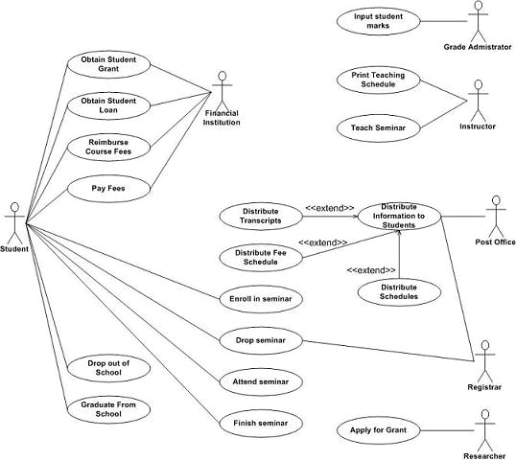
Example Use-case Diagram for a student database

